Slide 1
Tsinghua University Economic History and Development in Latin America Instructor: Prof. Lucas Llach (affiliation: Universidad Torcuato Di Tella, Argentina) Lecture 6/8. Accomplishments and Limits of Import-Substituting Industrialization

Slide 2
Roadmap
What was I.S.I., import-substituting industrialization?
Comparative Performance of ISI within LatAm and against other emerging economies.
Limits of I.S.I.

Slide 3
Roadmap
What was I.S.I., import-substituting industrialization?
Comparative Performance of ISI within LatAm and against other emerging economies.
Limits of I.S.I.

Slide 4
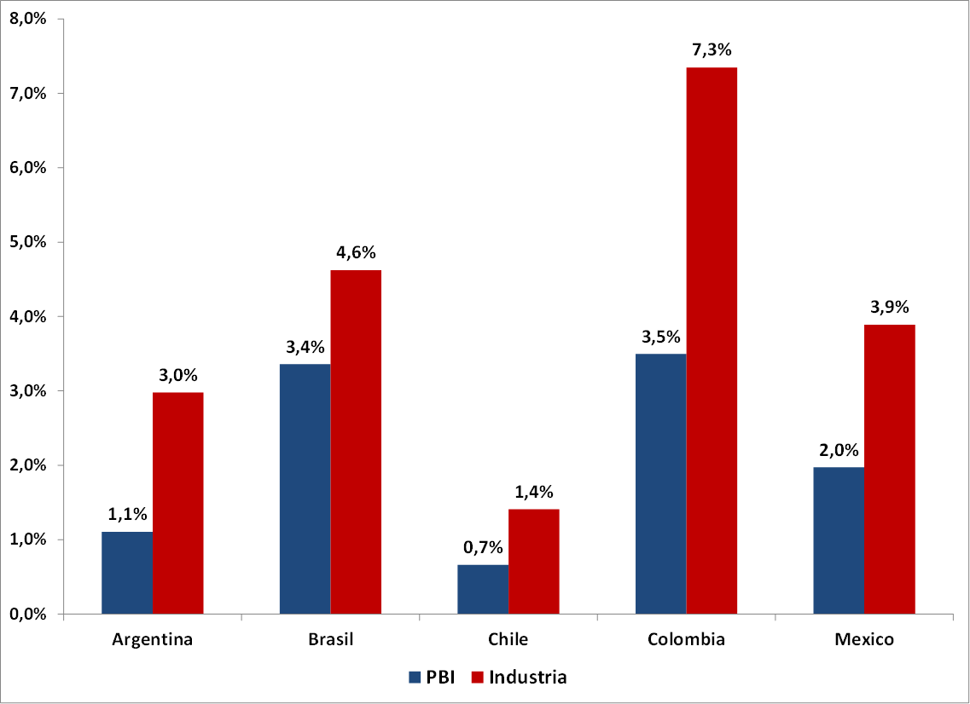
GDP and manufacturing rates of growth in the 1930s

Slide 5
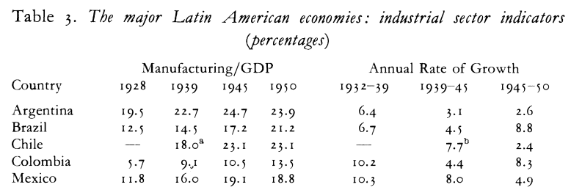
Manufacturing: Change or Continuity?
Source: R. Thorpe (1992)

Slide 6
Industrialization in LatAm
Joseph Love (1994): "Industrialization in Latin America was a fact before being a policy, and a policy before being a theory".
Hirschman (1971): "It was expected that industrialization would change the social order, and all it did was to produce manufactures".

Slide 7
The Rationale of Protection
Fiscal (clear since the 19th century)
Interest groups (starting in the late 19th century).
Defence of the balance of payments (1930s?)
Employment, manufacturing (since the 1930s)
Real wages? (same as "employment" plus effect on food prices in food exporters).

Slide 8
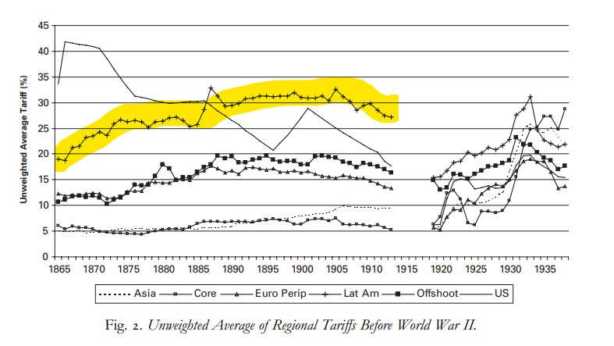
Always Protectionist? Why?

Slide 9
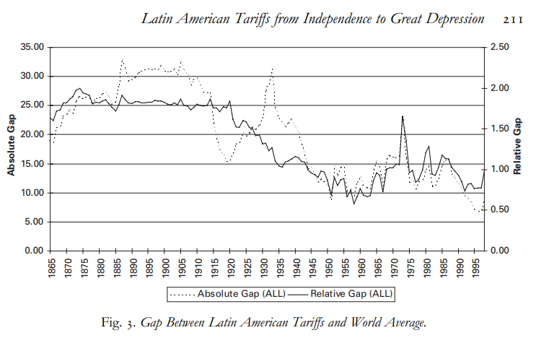
Always Protectionist? Why?

Slide 10
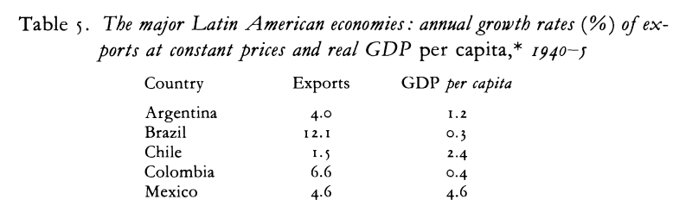
War
Some increase in intra-LatAm exports.
"Plan Pinedo" of Argentina a first blueprint at regional (re?)integration.
Source: R. Thorpe (1992)

Slide 11
Postwar: The Rationale of Import Substituting Industrialization (ISI)
Depression + war: back to normal?
Theory and the ISI (a good synthesis here)
The 2 sector models and modernization
Big Push
Balanced v unbalanced growth
Forward and backward linkages
The "Lewis" model
Prebisch and export pessimism
The distributional impact of ISI.

Slide 12
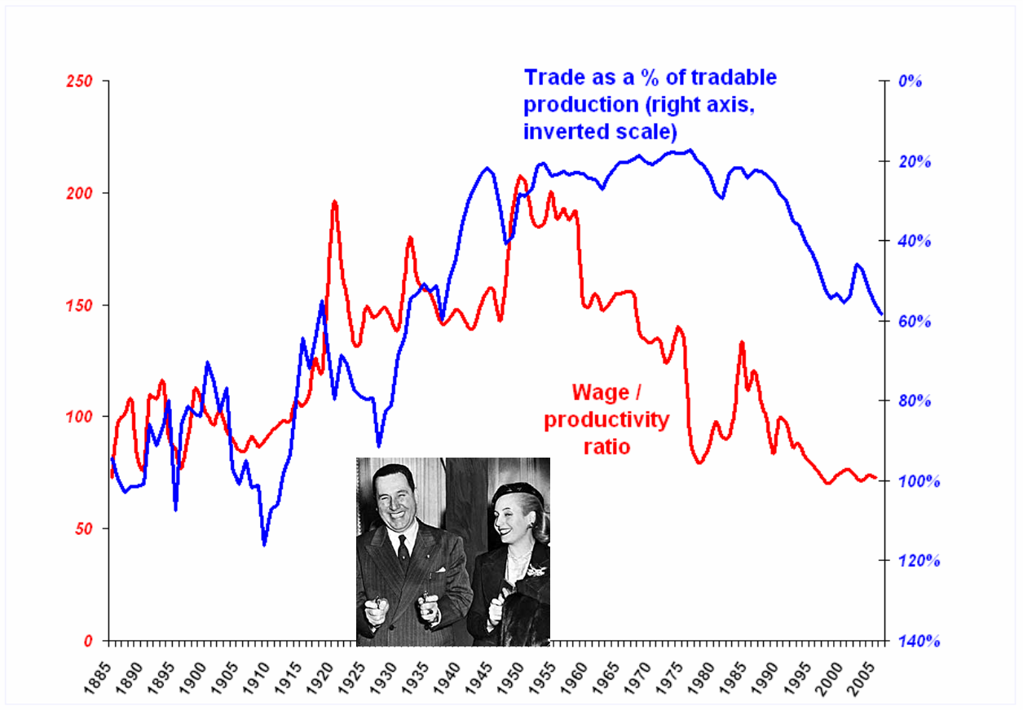
Trade theory & the distributional effects of ISI

Slide 13
Postwar: Industrialization as a policy The instruments
How to promote an inward-looking industrialization?
Tariffs
Import quotas
Multiple exchange rates / taxes on exports
Directed credit
State property in big scale projects

Slide 14
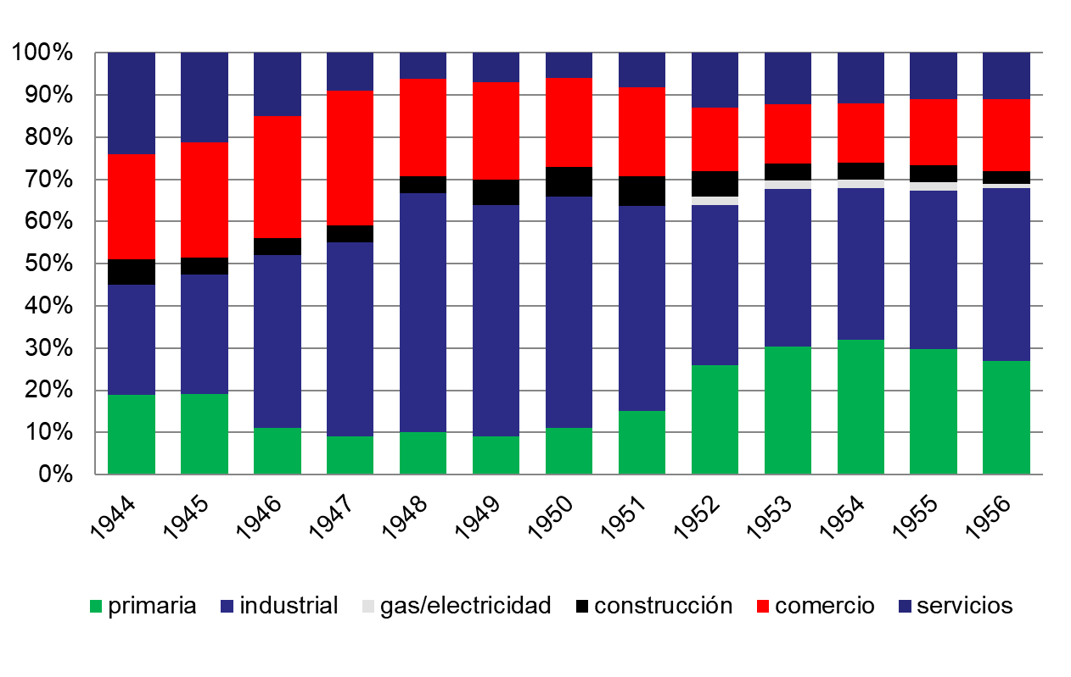
Directed credit: Argentina

Slide 15
Roadmap
What was I.S.I., import-substituting industrialization?
Comparative Performance of ISI within LatAm and against other emerging economies.
Limits of I.S.I.

Slide 16
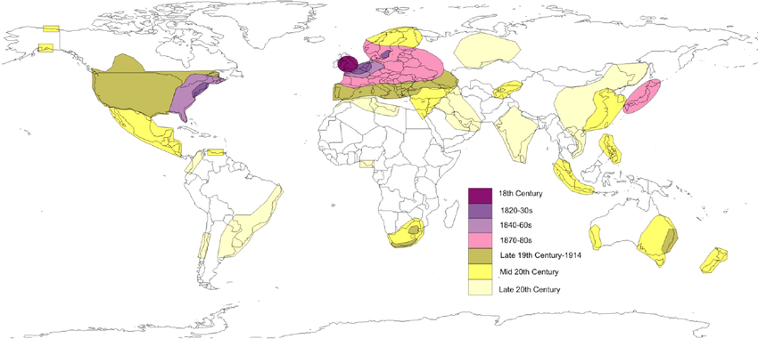
LatAm, not the only "late industrializer"
Asia and Eastern Europe also faced the challenges of late industrialization
What were the similarities and differences?

Slide 17
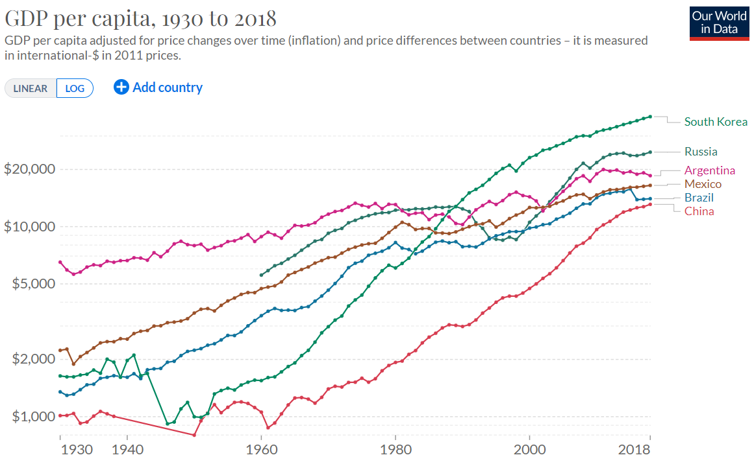
Three main models of (very) late industrializers
The ISI model (LatAm, India)
The East Asian model (Korea, Taiwan, China?)
The "real socialist" model (USSR and Eastern Europe)

Slide 18
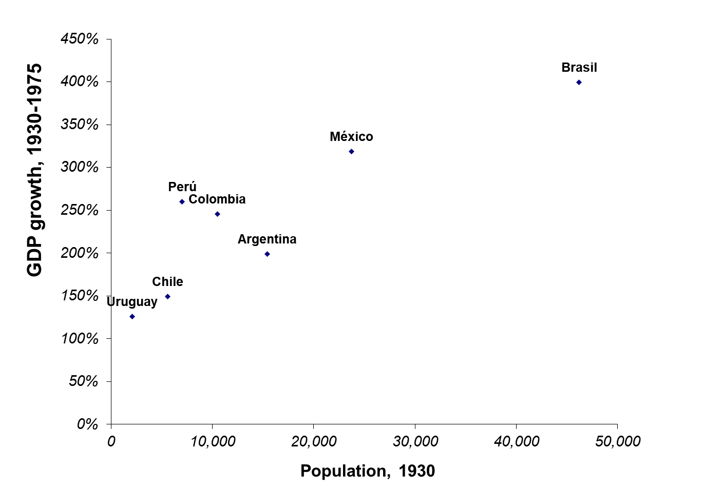
Performance differences within Latin America: size...

Slide 19
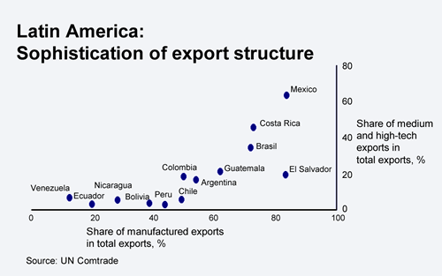
... and ultimately comparative advantages
(current situation)

Slide 20
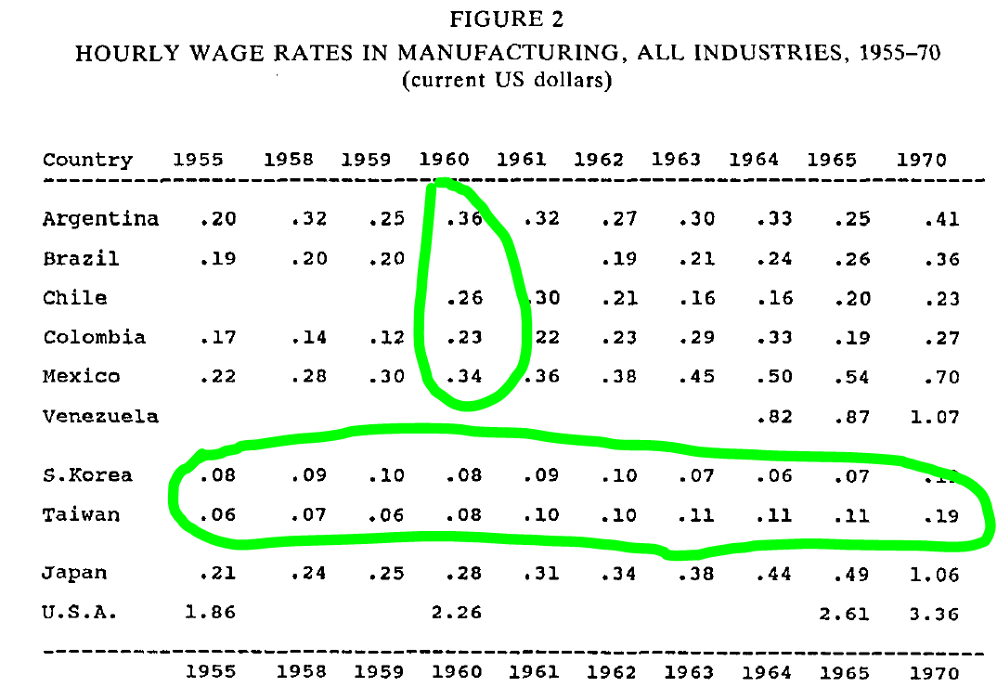
Why ISI and not EOI, export oriented industrialization?
Export orientation could have avoided the "too small to industrialize" problem.
Were LatAm countries ready to export manufactures, or "too rich to industrialize"? (Mahon)

Slide 21
Roadmap
What was I.S.I., import-substituting industrialization?
Comparative Performance of ISI within LatAm and against other emerging economies.
Limits of I.S.I.

Slide 22
Limit 1: "foreign exchange bottlenecks" & stagnations
"Easy stage" of industrialization (textiles, simple metalworking)
"Difficult stage": technology + capital intensive + big scale (petrochemical, steel)
Normally capital intensive industries required capital goods imports; and all manufacturing required imported inputs, but...
...exports were stagnant because of anti-export bias
Welcome to the STOP AND GO...

Slide 23
Limit 1: "foreign exchange bottlenecks" & stagnations
The answer of desarrollismo (late 1950s/1960s)
Welcome to foreign capital for investment, esp in inputs (eg., oil)
Don't be too harsh on traditional exports
Frondizi (Argentina), Kubitschek (Brazil).
OIL + MEAT = STEELMAKING + PETROCHEMICALS

Slide 24
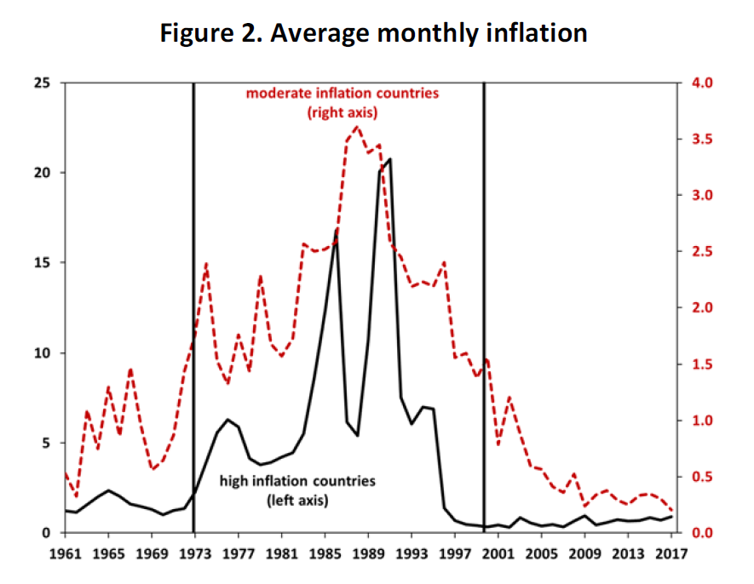
Limit 2: high inflation
Source: Keohe, Nicolini & Sargent

Slide 25
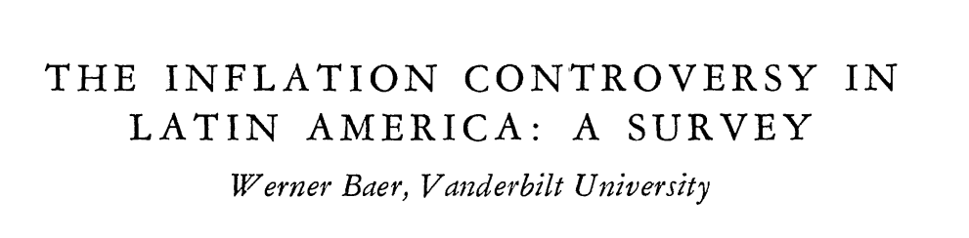
Limit 2: high inflation Causes
MONETARIST
Persistent inflation is just the result of persistent fiscal deficits and their "monetization" (inflation tax)
Solution requieres budget equilibrium & orthodox monetary policy
STRUCTURALIST
"Elasticity" problems. Economies very dependent on imports (devaluation) and with low elasticity of export & food production.
Solution requieres solving those real bottlenecks.
Source: Keohe, Nicolini & Sargent

Slide 26
What After ISI (1970s)
The "New Strategies"
Export promotion: manufacturing with comparative advantages
Back to specialization (especially smaller countries)
The Return of Finance

